Slide 1
Welcome!
Electrical Training Week 3

Slide 2
Last Week!
Introduction to PCBs
Introduction to EAGLE CAD
Parts and Libraries in EAGLE
Configuring EAGLE Setup
Making a Part in EAGLE

Slide 3
This Week!
Communication Systems
EAGLE Schematics

Slide 4
Communication Systems
How many are there again…?

Slide 5
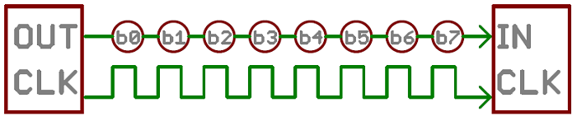
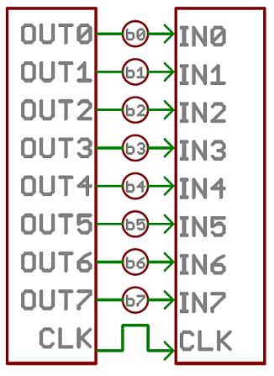
Serial vs Parallel Communication
Serial
Parallel
Many bits of data sent at the same time through different wires.
Example: PCI and DIMM (on computer motherboards)
Stream data one bit at a time
Example: USB, SPI
Notes:
Most communication that happens in embedded devices uses Serial interfaces to save wires

Slide 6
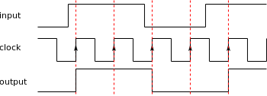
Clock Signals
Square waves of known frequency (baud rate)
Edge used to synchronize data reading across communicating devices
Notes:
Output updates on the rising edge of the clock signal

Slide 7
Push-Pull vs Open-Drain
Push-Pull
Lines are either driven low in the push phase or driven high in the pull phase
Usually used for single direction lines
Open Drain
Pin is floating (high impedance) until it is driven low. Can be pulled high externally
Used for communication with bidirectional communication on one line

Slide 8
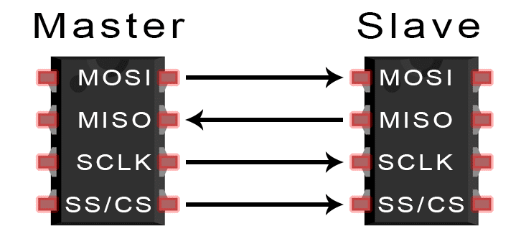
SPI (Serial Peripheral Interface)
Continuous bidirectional transfer
All devices share 3 Lines
Unique Slave Select line per device
Master controls CLK
Notes:
Uses: AVR ICSPs, RoboRacing and IGVC Radio Modules

Slide 9
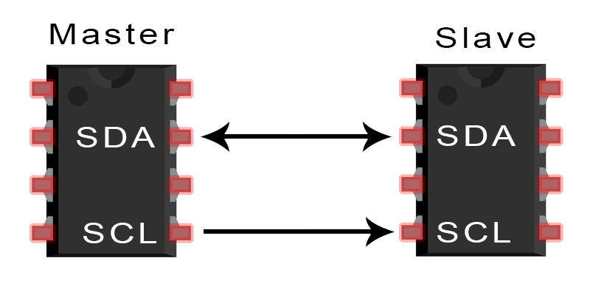
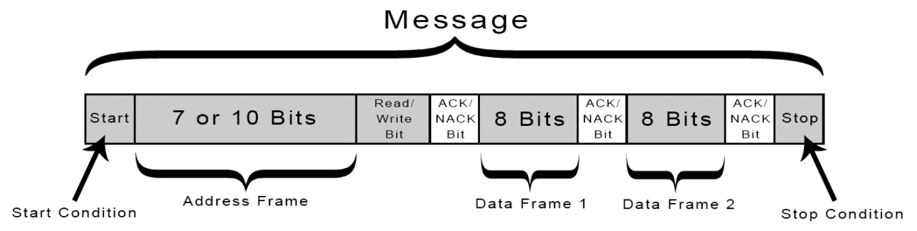
I2C (Inter-Integrated Circuit)
Synchronous
Uses only two wires :
SCL: Clock signal
SDA: Data signal
Sends data in ‘frames’
Any device can claim master by controlling SCL
Notes:
RoboCup Gyroscopes, RoboRacing and Sumo (?) Distance sensors

Slide 10
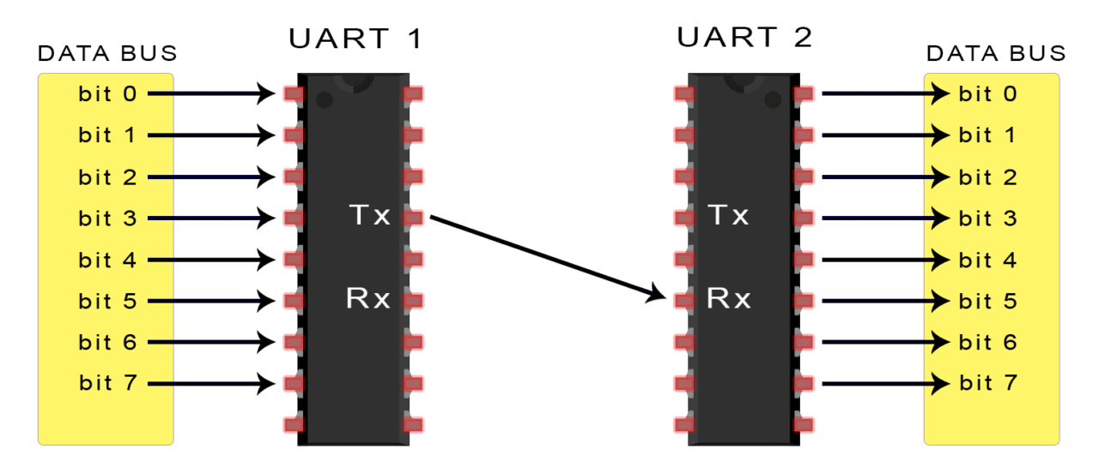
UART (Universal Asynchronous Receiver/Transmitter)
Asynchronous (no clock needed)
Uses 2 wires
Need same baud rate
Notes:
Communication between FTDI/USB chip and Main microcontroller

Slide 11
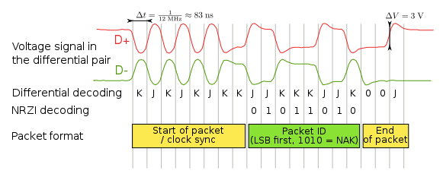
USB (Universal Serial Bus)
Differential Pair signal
Defines rate in “clock sync” phase
Useful for computer-device communication
Notes:
If someone doesn’t know what an example of a USB is...

Slide 12
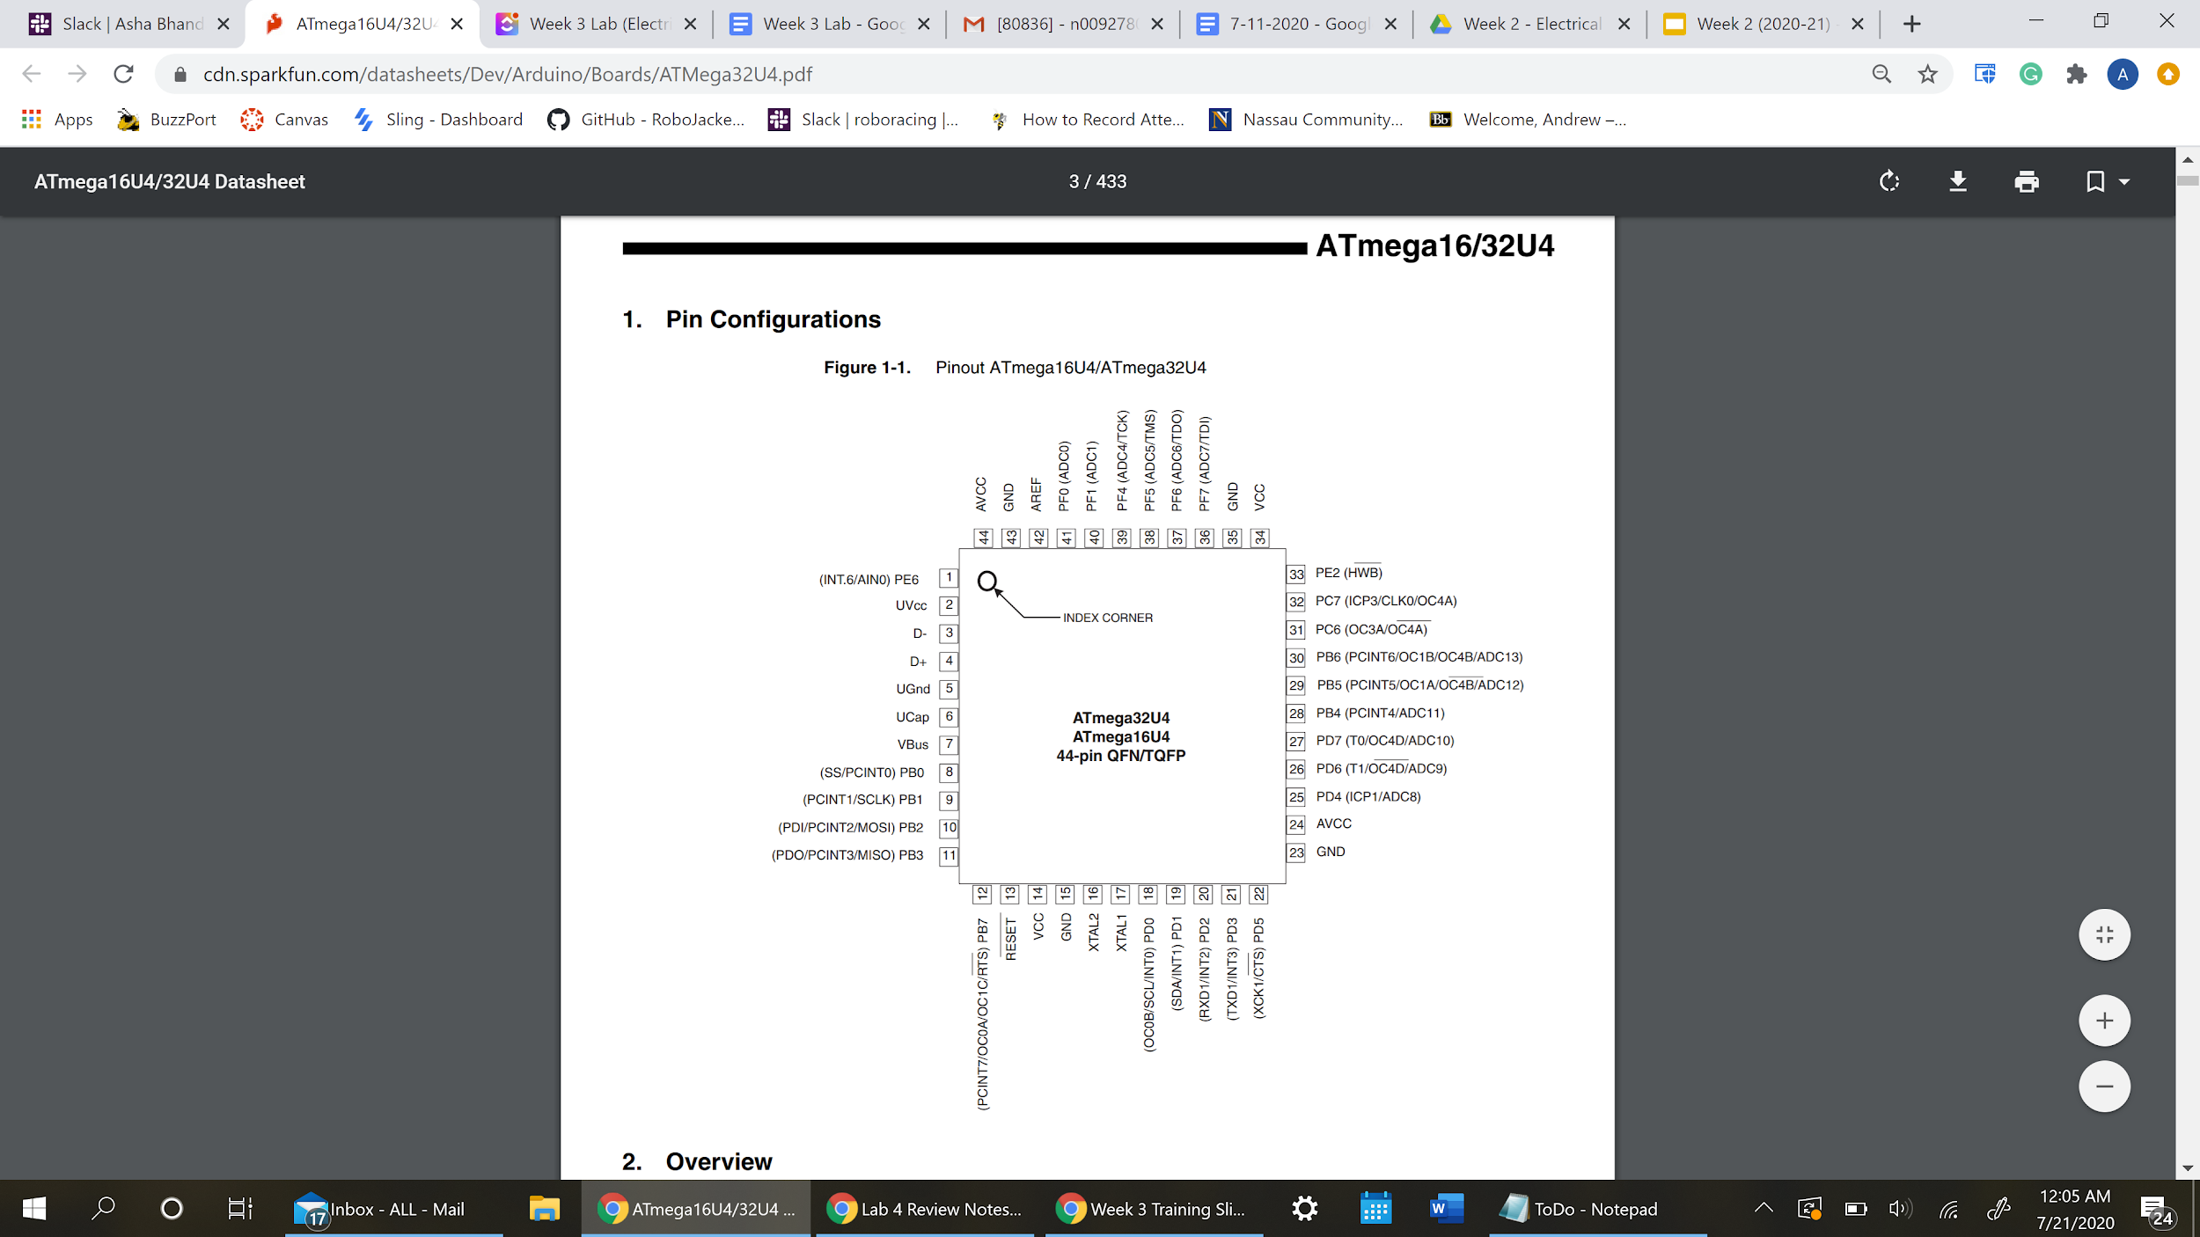
ATmega32u4 (MCU) Pinouts
Shows pin configurations and functions on the training board microcontroller
Datasheet
Notes:
Used to show where SPI connections are made

Slide 13
EAGLE Cont.

Slide 14
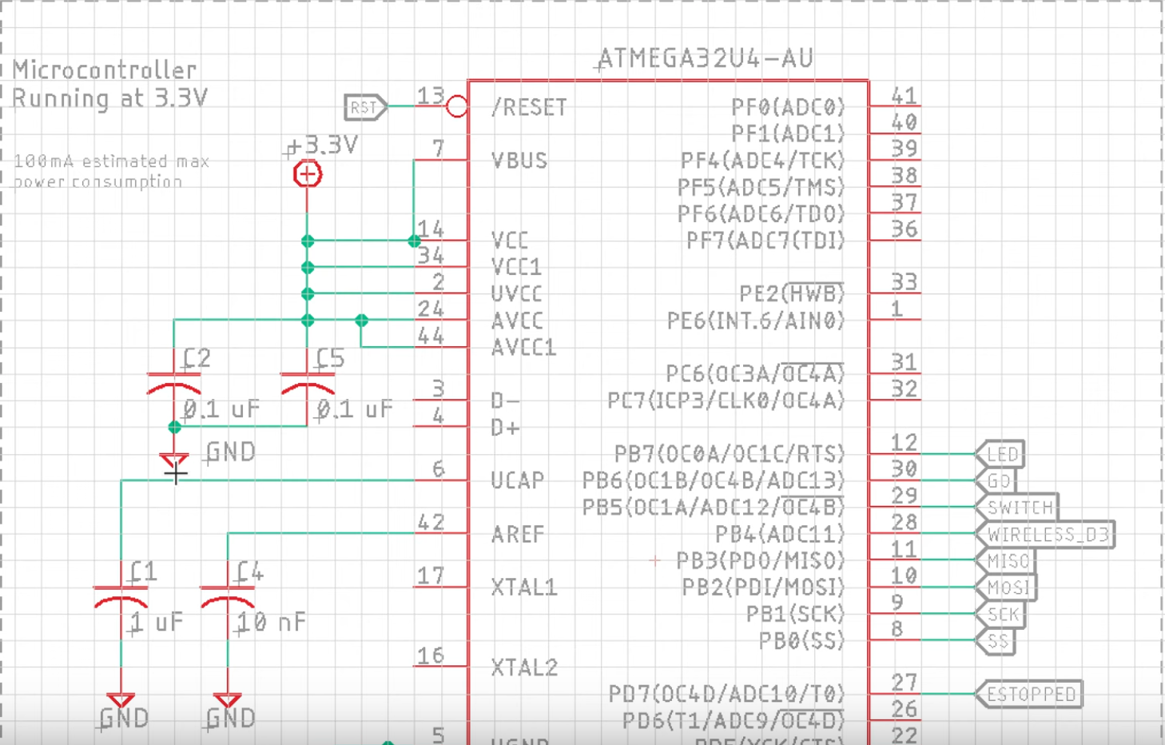
Goals by End of Today (Schematics)

Slide 15
Some Useful Features to Know

Slide 16
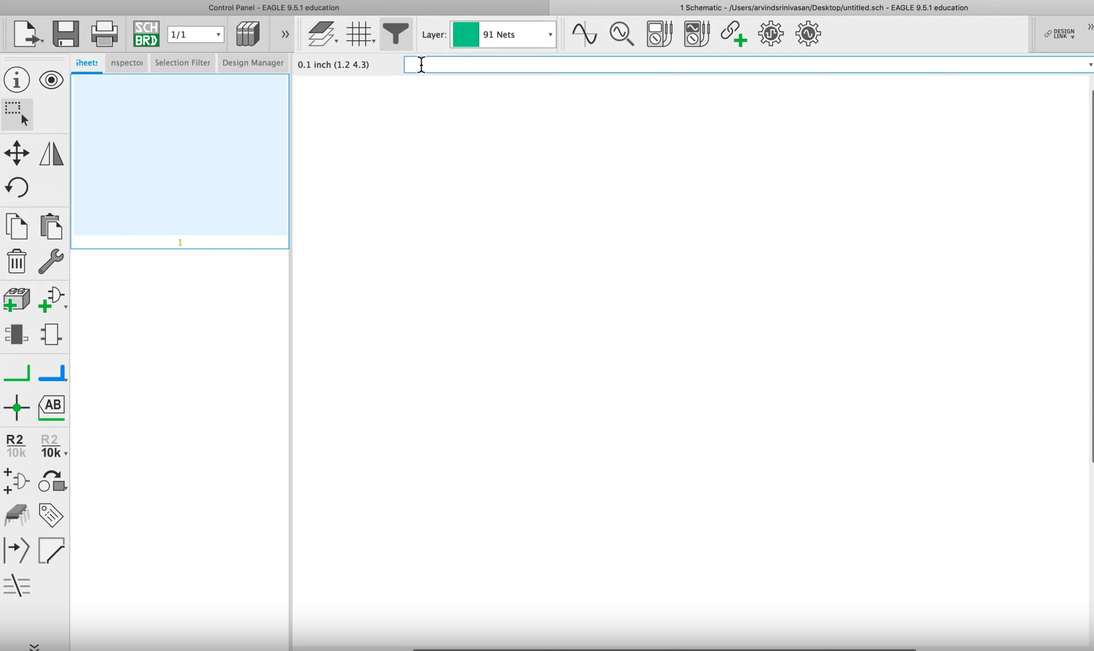
SideBar Tools
Most actions and tools are in the bar on the left (ex. move, add ERC)
Notes:
SideBar before command line

Slide 17
Command Line
You can also perform actions by typing them in the command line (ex. Moving parts, ERC)
Notes:
SideBar before command line

Slide 18
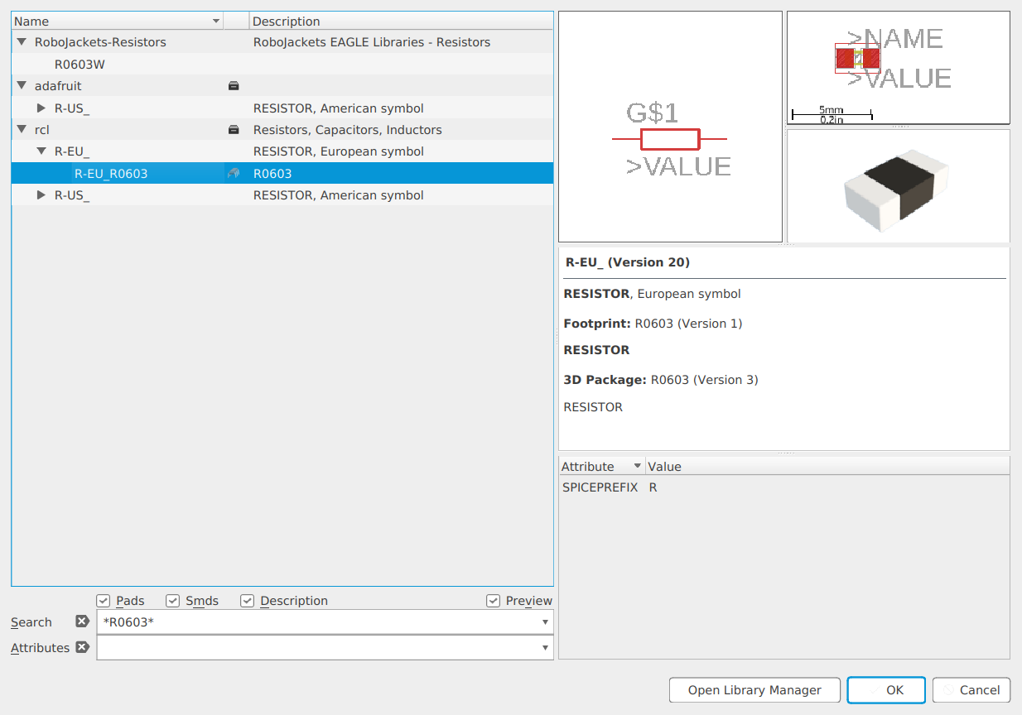
Searching for Parts
Use wildcard character if you don’t have a perfect match

Slide 19
Searching for Parts
Placing asterisk symbols before and after part name you typed will search for parts that include those characters if you can’t get perfect match (called wildcard)
We’ll go more in depth about searching for parts but for now, PLEASE DON’T FORGET the wildcard feature

Slide 20
EAGLE Resources
Detailed walkthrough of all EAGLE features
/references/eagle_training_guide/eagle_guide.pdf
Quick “cheat sheet” to look at for command names
/references/eagle_training_guide/eagle_cheat_sheet.pdf
Videos
YouTube -> RoboJackets Training -> Playlists -> EAGLE Training
Notes:
HyperLink

Slide 21
How to Build your Own Schematic
Notes:
Font (Double check week 1 and week 2 for fonts)

Slide 22
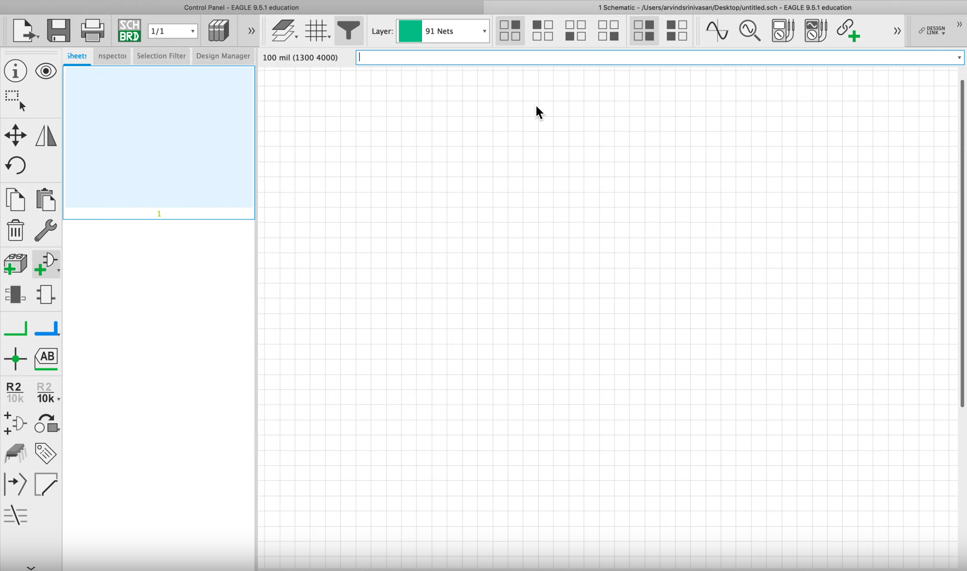
Step 1: Grid Lines
Click on Grid Menu
Or type “Grid” here
Your screen should look like this.

Slide 23
Step 1: Grid Lines
Open up the grid menu by either clicking on the grid menu at the top or typing “grid” into command bar and make sure:
Display is on
Style is line
Size is 0.1 in inches
Alt is 0.01 in inches
The previously blank page should now have grids
Notes:
Inches

Slide 24
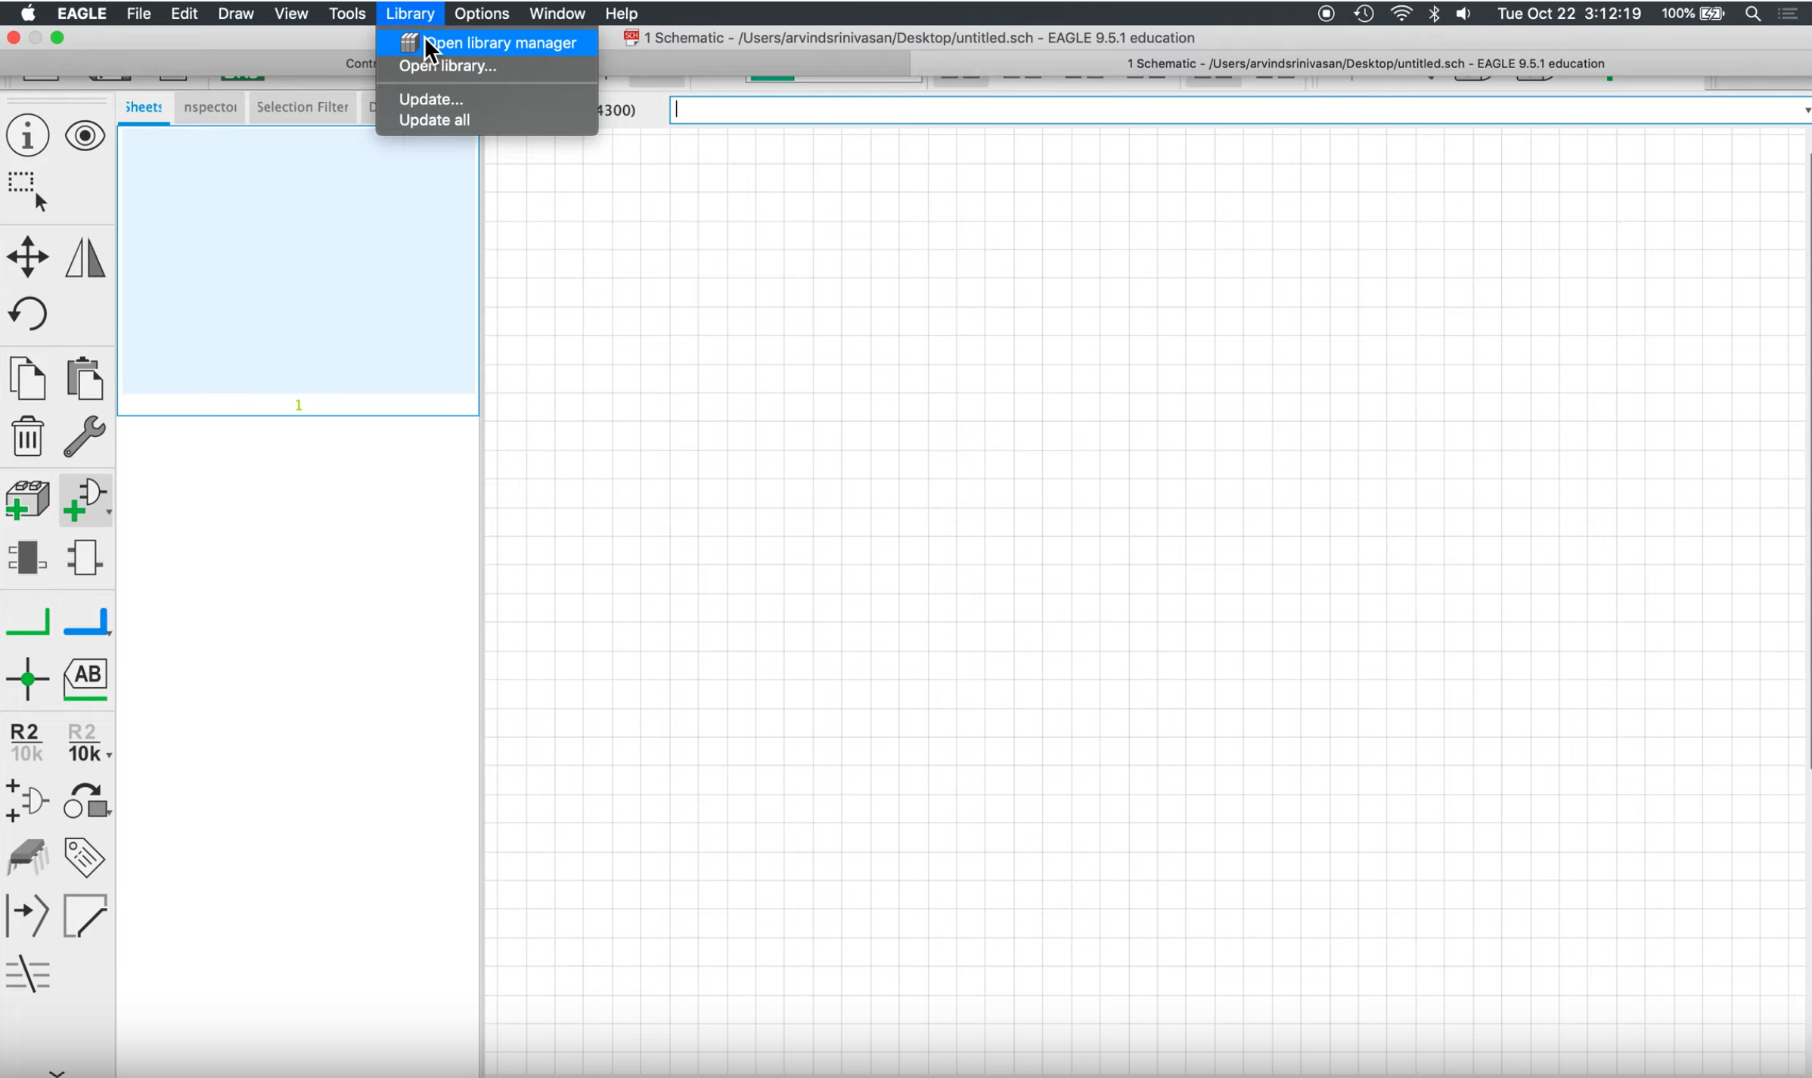
Step 2: Library Settings
Open library and then “Open library manager”
The point of this step is to make sure we are using the RoboJackets library for parts.

Slide 25
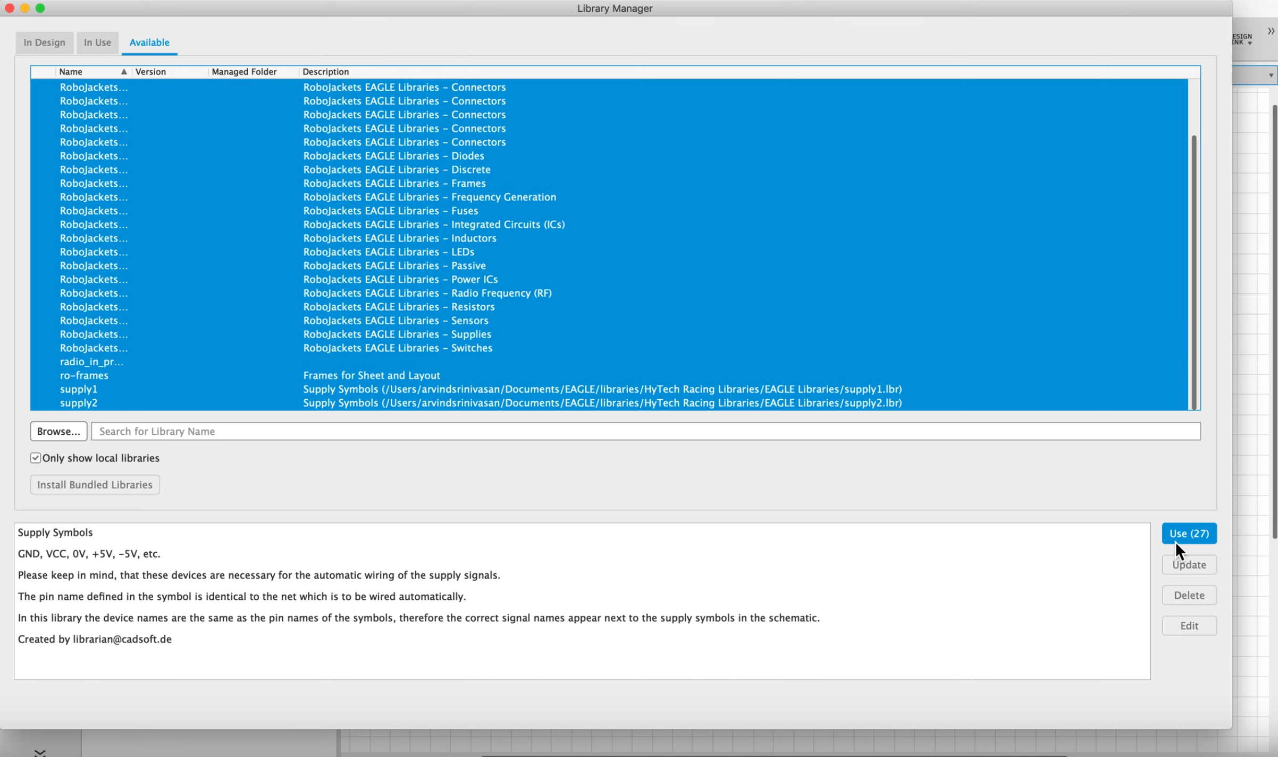
Step 2: Library Settings
“Available” tab
Click the “Available” tab and click & drag the RoboJackets parts. Then click “Use” on the bottom right side of page.
Click “Use”
Notes:
Could need to use browse feature before going through available tab

Slide 26
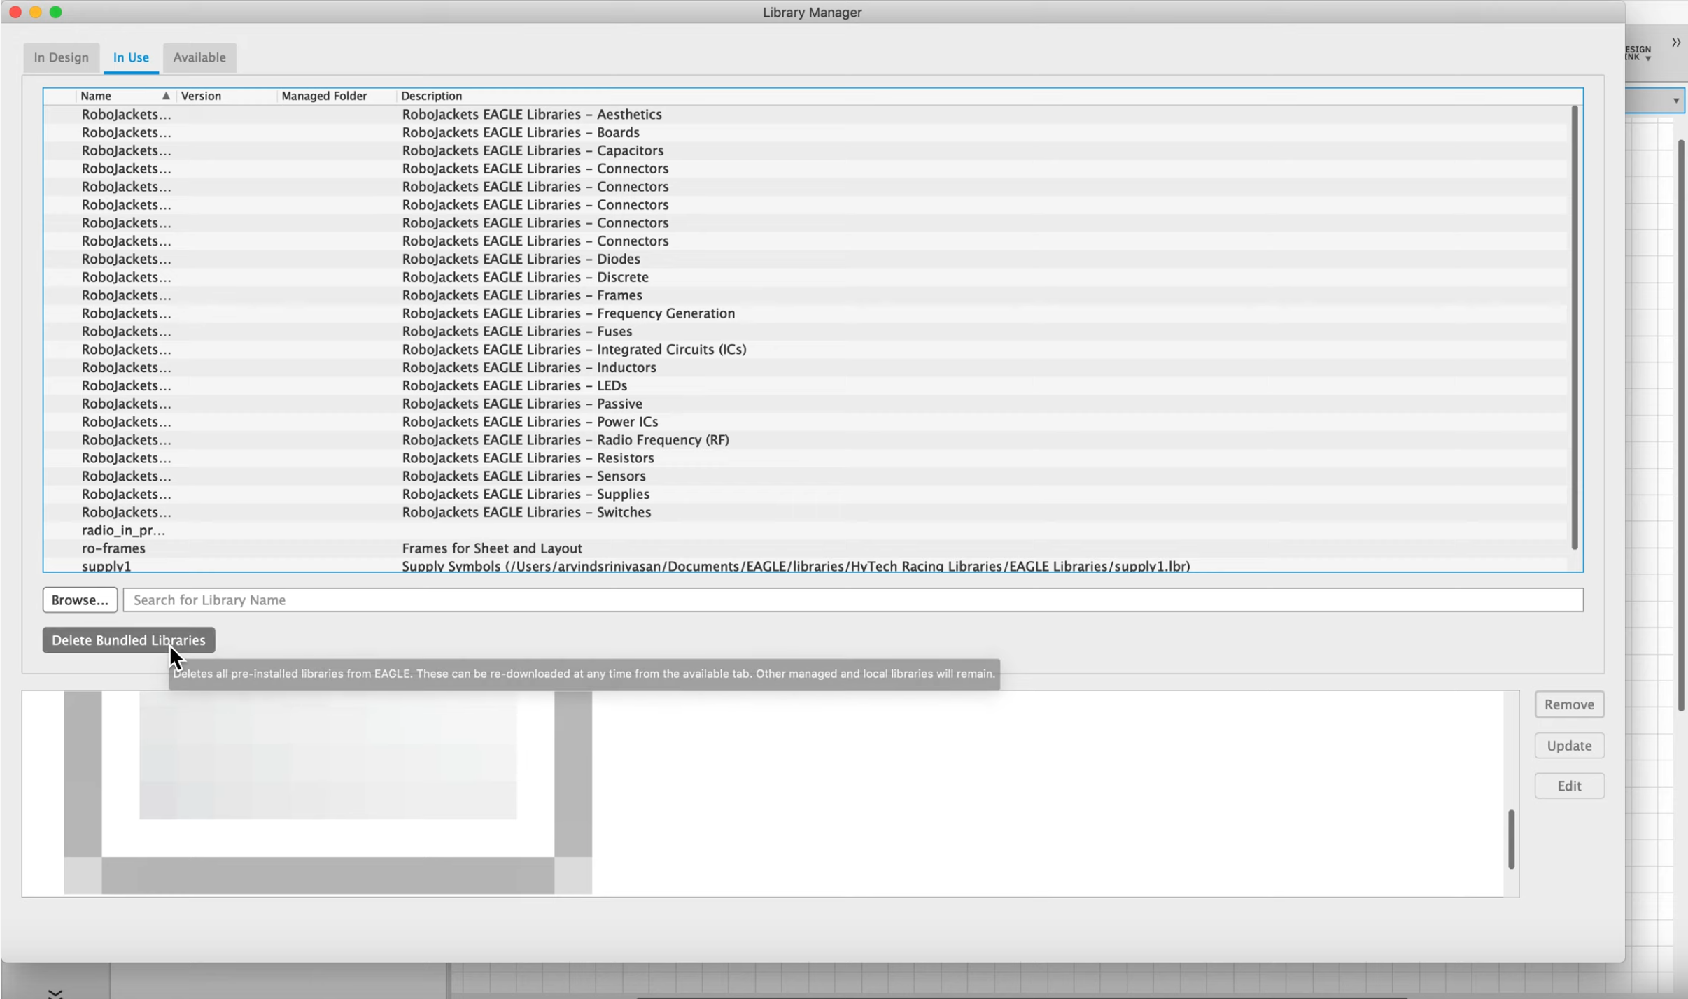
Step 2: Library Settings
“In Use” tab
Click on “In Use” tab and then click “Delete Bundled Libraries”
“Delete Bundled Libraries”

Slide 27
Side Note
You may or may not have to use the “Browse” Feature to see the parts
“Browse” Feature

Slide 28
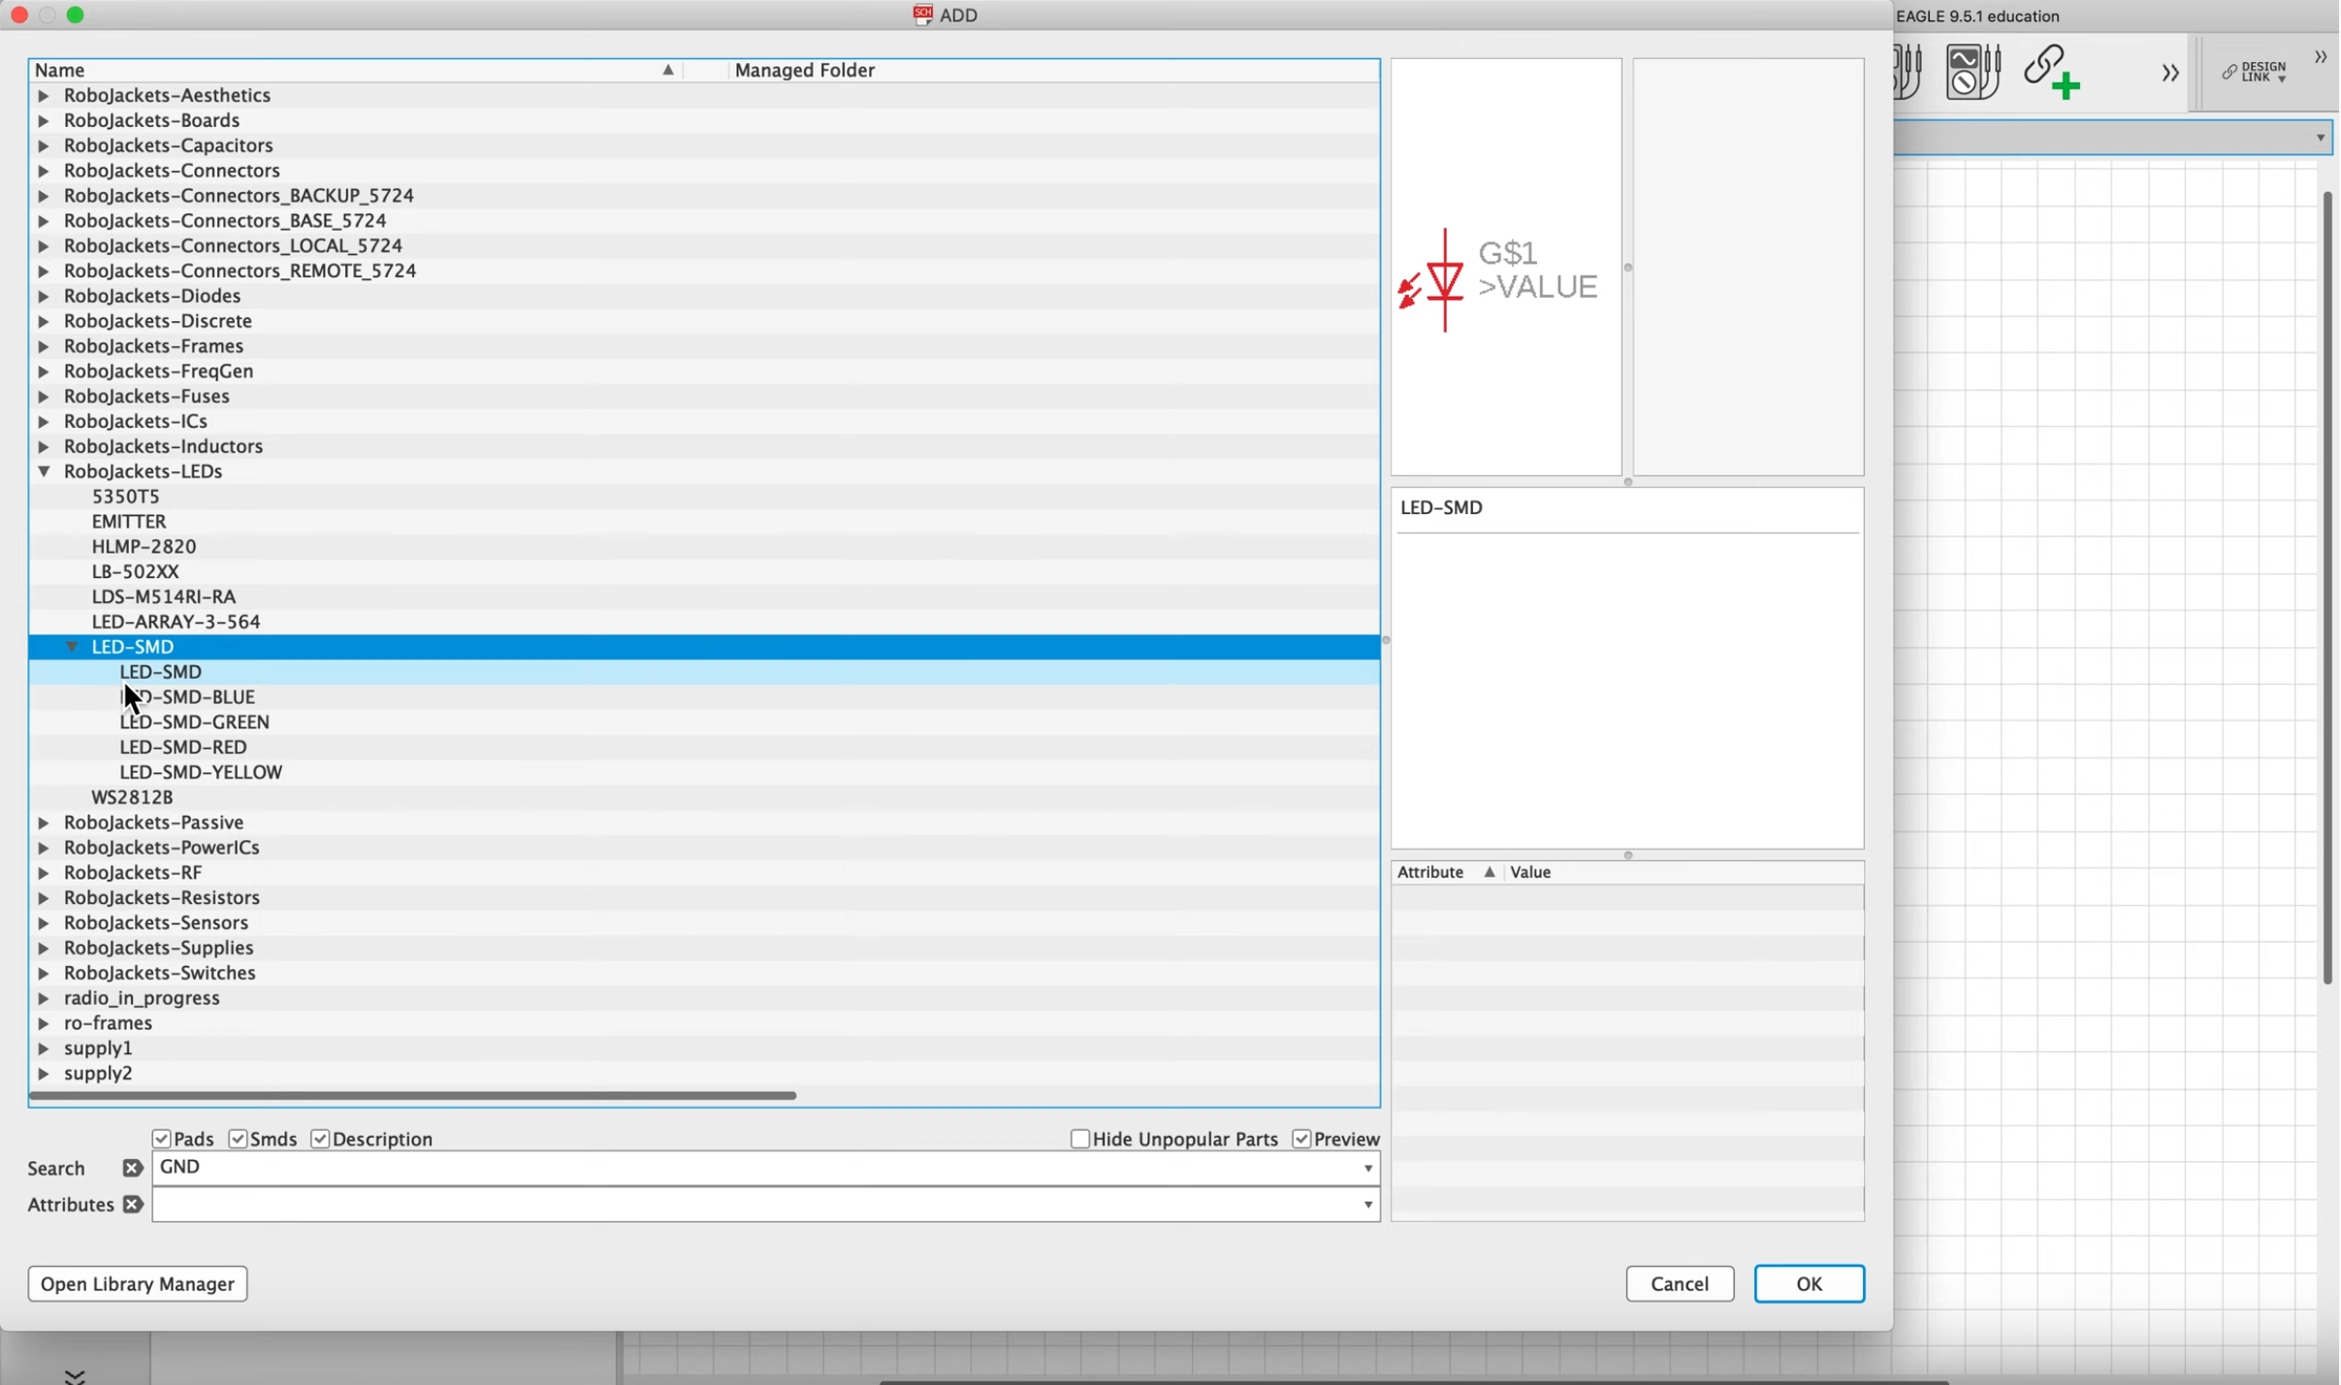
Step 3: Adding Parts
Search for the part using folders
Double click on the part and then click on the grid line where you want the part to be.
Or search for the part using the search bar

Slide 29
Step 3: Adding Parts
This step is where we’ll be adding the parts that we’ll need
Click on “Add Part” from the bar at the left or type “add” in the command bar
You can search for the part through the folders or typing it in the search bar
If you can’t find the exact part through the search bar, remember that wildcard exists

Slide 30
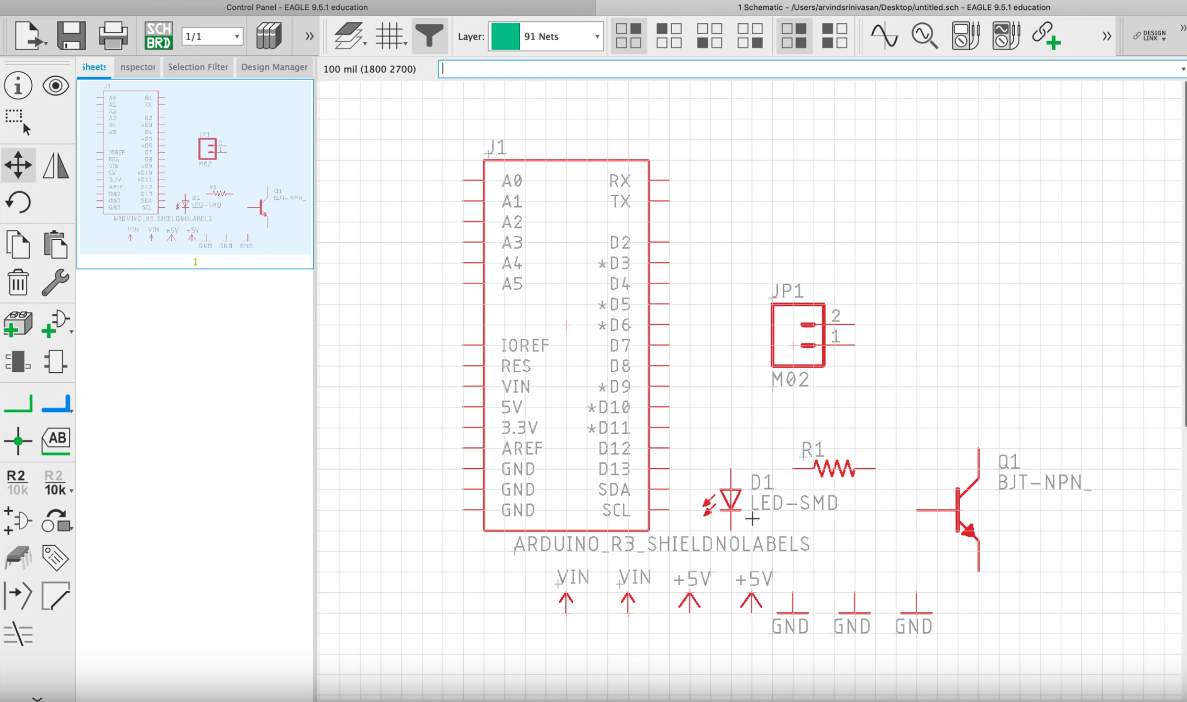
Step 4: Rearranging Parts
Click
Move
Click
Rotate
Or type “move” or “rotate”
Once you click move or rotate, click on the part to interact.

Slide 31
Step 4: Rearranging Parts
After you’ve found most or all of your parts, we may need to rearrange their positions or orientation
You can move your parts around the grid by clicking “Move” on the left bar or typing “move” in the command bar (You can also right click to rotate while part is selected and being moved)
You can rotate your parts by clicking “Rotate” on the left bar or typing “rotate” in the command bar
Notes:
Using right click to move

Slide 32
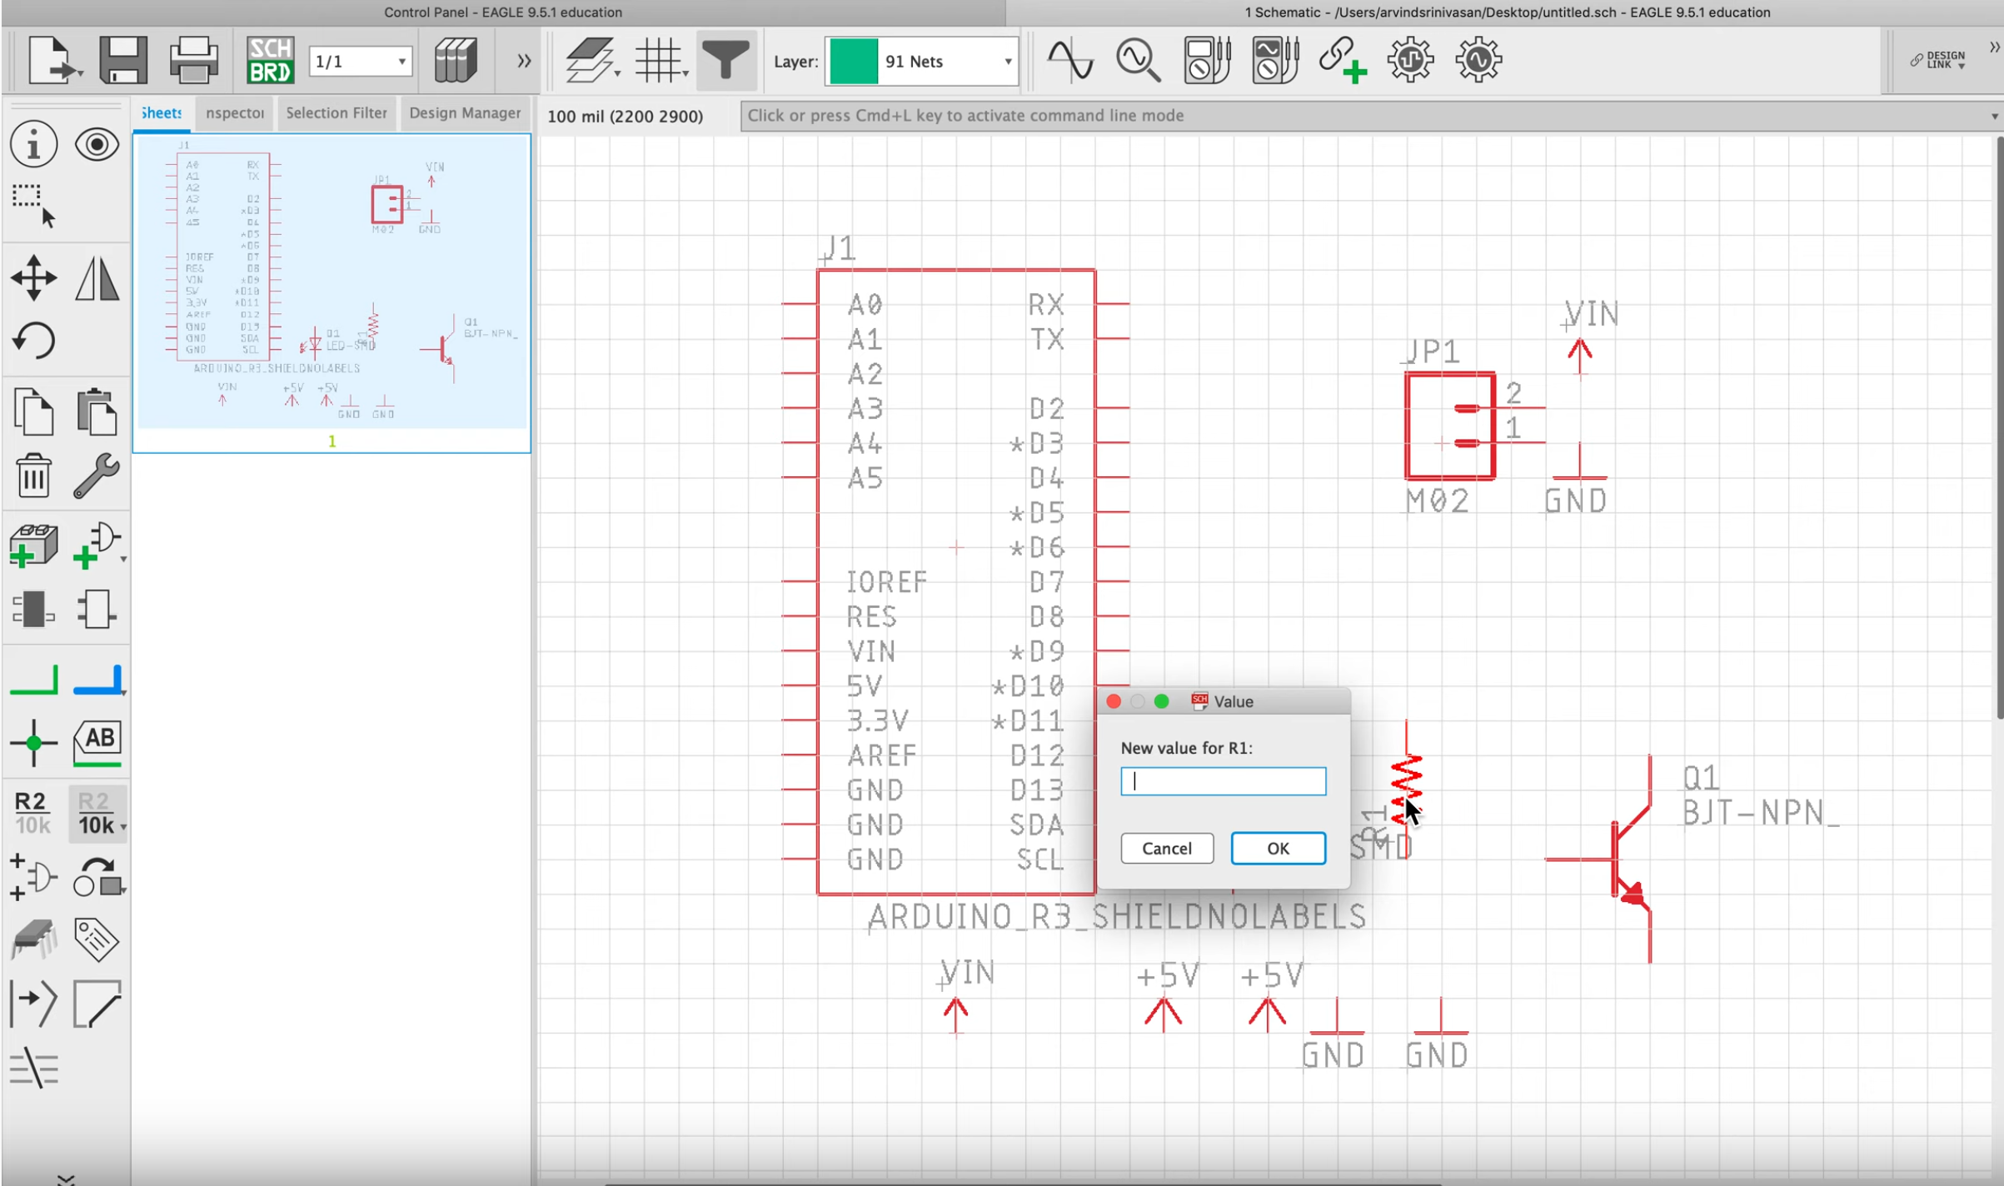
Step 5: Setting Value of Parts
Or type “value”
Click
Value
Set the amount and then click “ok”

Slide 33
Step 5: Setting Value of Parts
To understand the schematic as a whole and how it interacts with other parts, some parts may need values to them such as resistors
Click “Value” on the left bar or type “value” in the command bar
Left click on the part to add the value and type the amount
Notes:
First bulletpoint

Slide 34
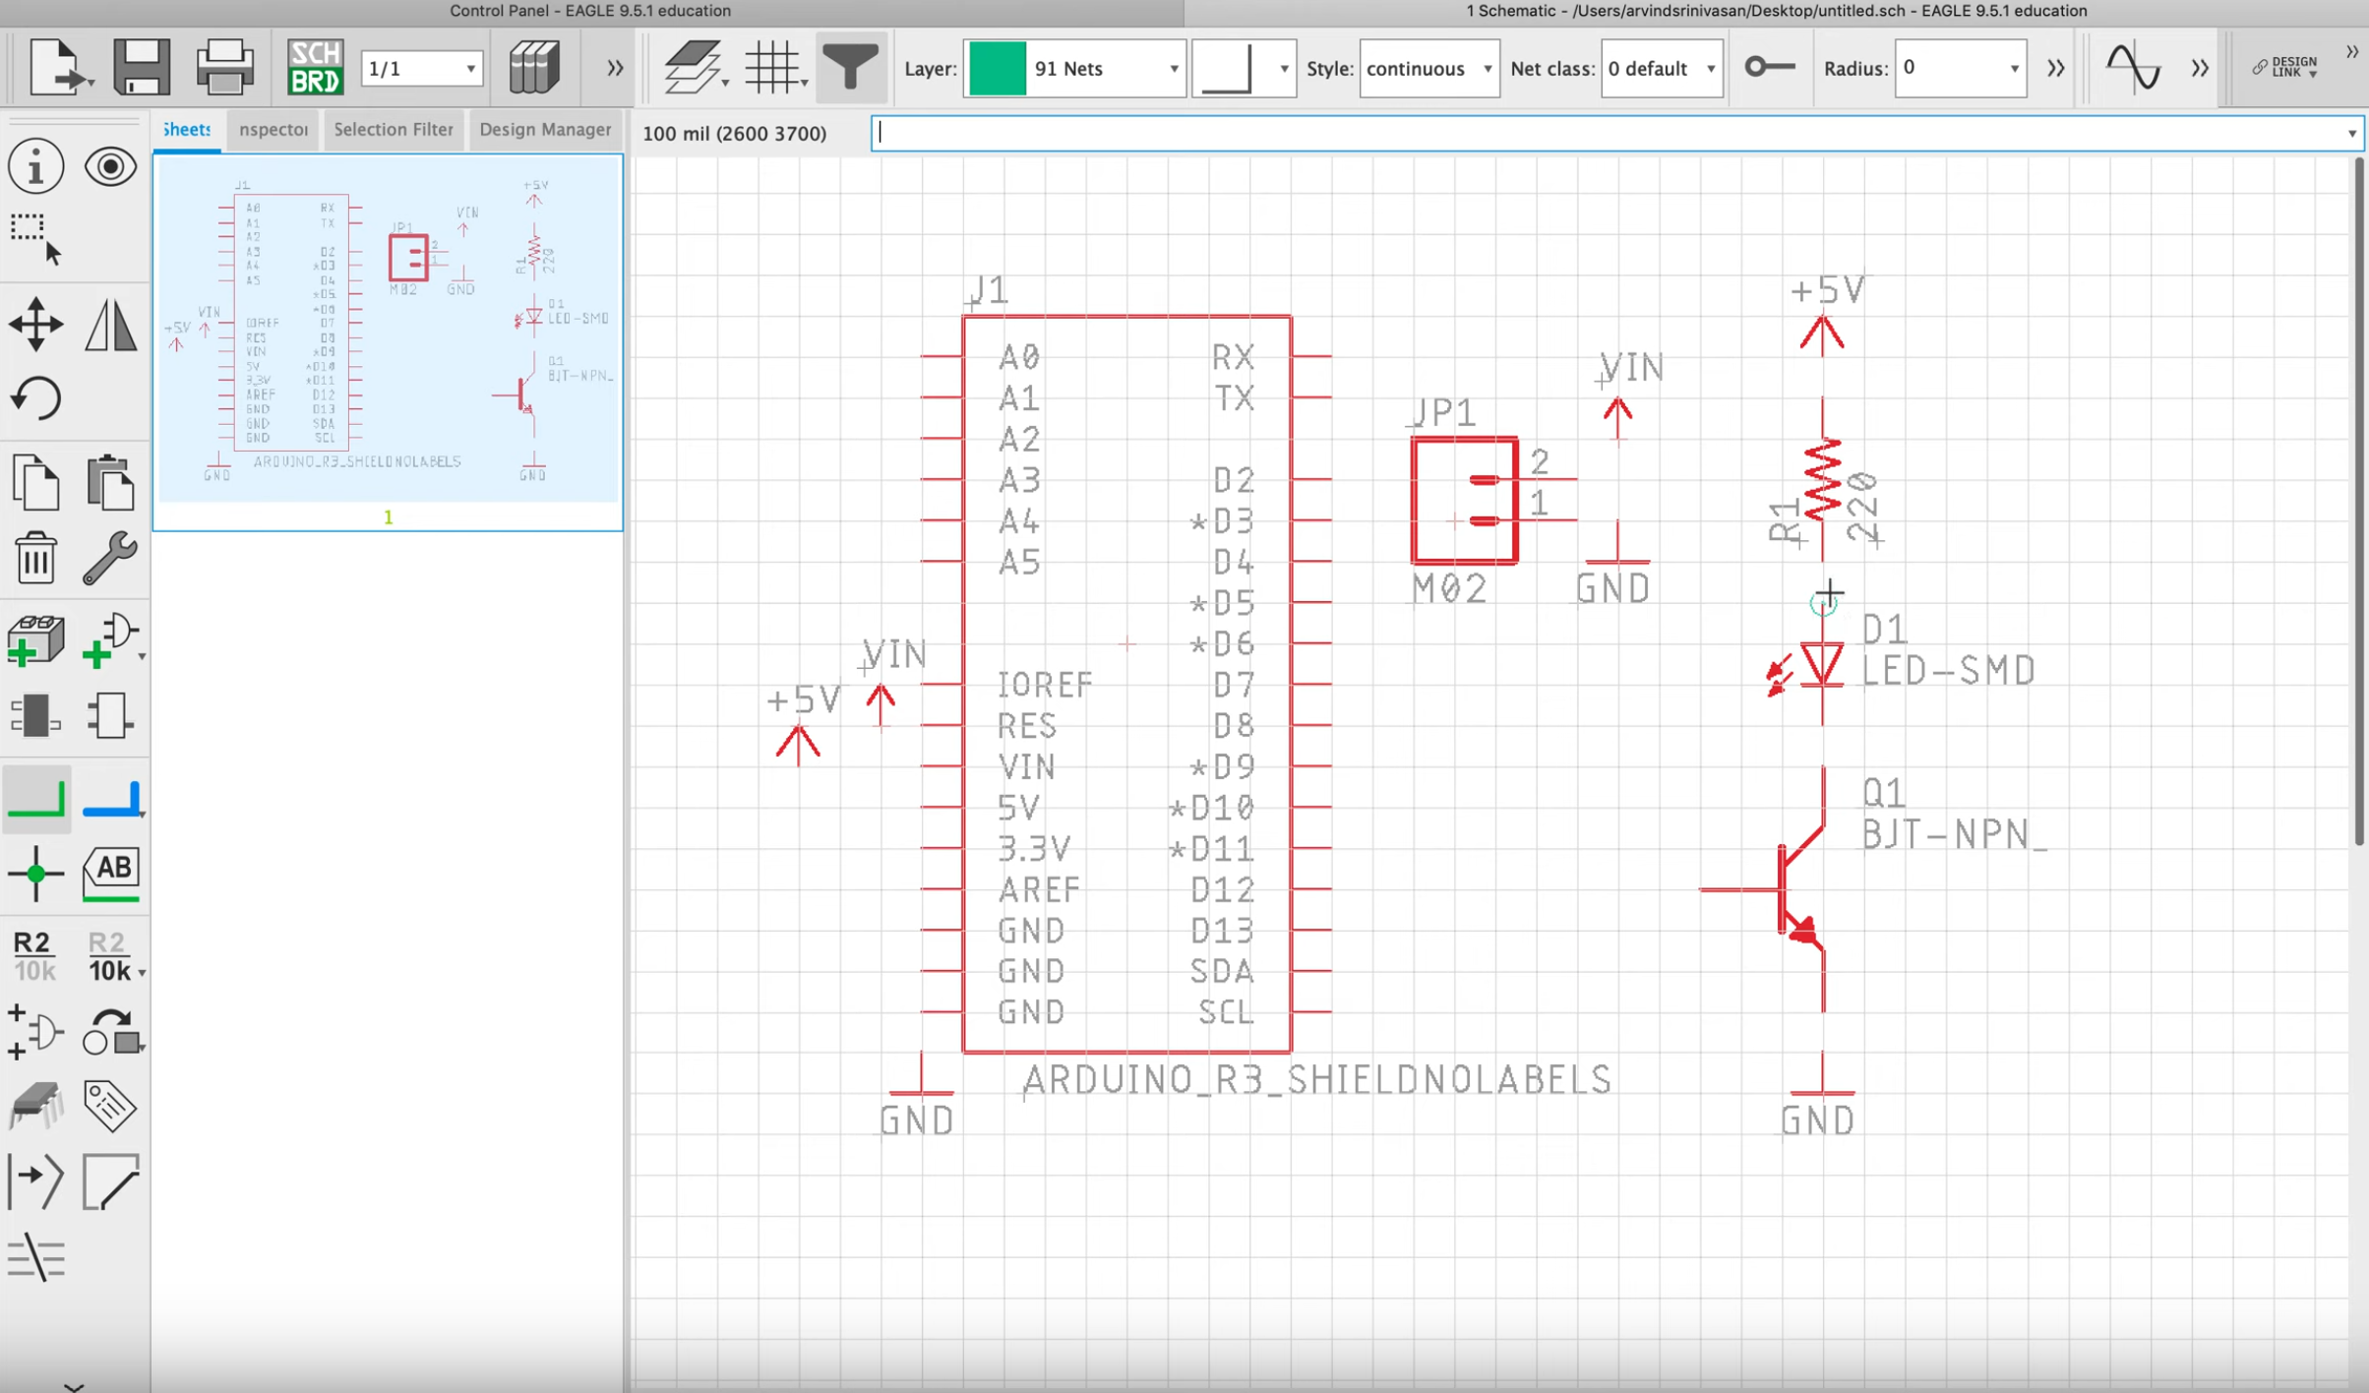
Step 6: Adding & Deleting Nets
Click
Net
Or type “net”
Click on the circle and drag it to another pin to create a connection
Notes:
After nets have separate step on labels

Slide 35
Step 6: Adding & Deleting Nets
To connect the parts, we need to add nets to them
Click on “Net” on the left or type “net” in the command bar
You can change the orientation of a net by right clicking it
If you hover over a part’s pin, you should see a small circle
Click on the circle and drag it to another part’s pin and then you should see the connection
If you made a mistake, click on “Delete” on the left or type “delete” in the command bar and then left click on the net

Slide 36
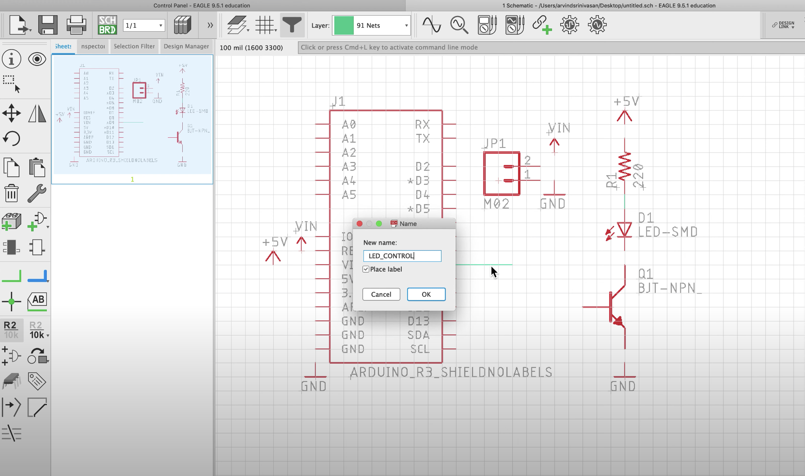
Optional Step: Naming
Or type “name” in the command bar
Click the name tool, then click on the net you want to name, and type a descriptive name for the net.
Click the name tool
Then click on the net you want to name
Notes:
After nets have separate step on labels

Slide 37
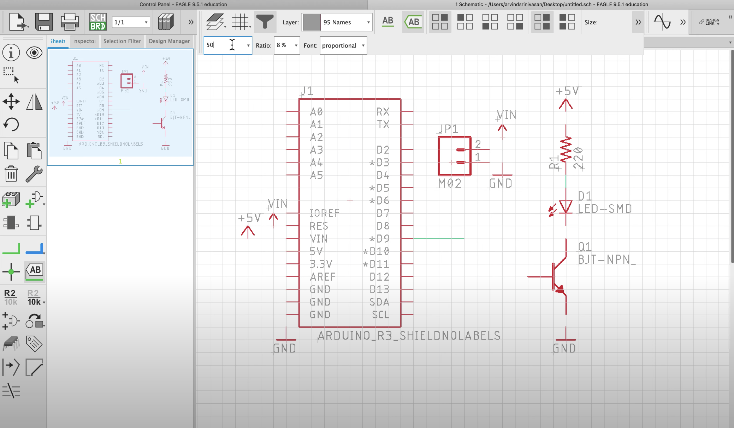
Optional Step: Label Settings
Make sure to set the label to trapezoid and size of 0.05
Click the label tool and make sure to set the label to trapezoid and size of 0.05 under the dropdown menu as shown in the arrows.
Click the Label tool
Notes:
After nets have separate step on labels

Slide 38
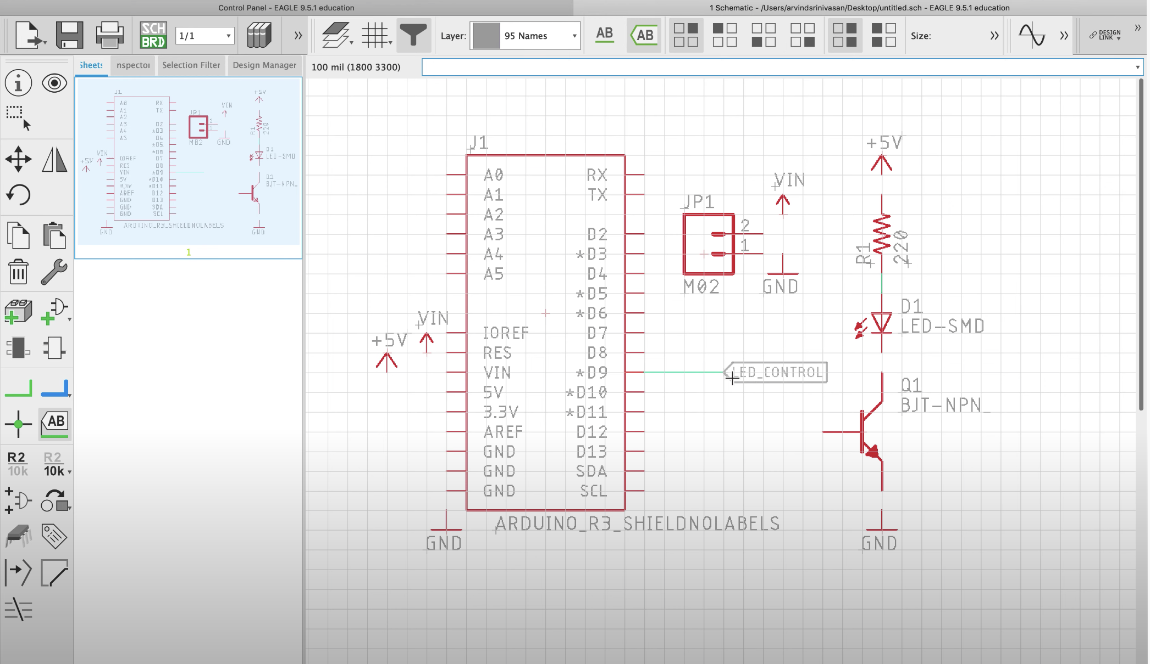
Optional Step: Label Settings
Click on the net and line up the label at the end of the net using right click to rotate
After adjusting the settings, click on the net and line up the label at the end of the net using right click to rotate.
Click the Label tool
Notes:
After nets have separate step on labels

Slide 39
Optional Step: Name and Label
In certain scenarios, you may want to name where your net is leading up to and display it on the schematic
The name tool must be clicked first and then the net you want to name
Once a descriptive name is typed, we can use the label button on the toolbar to display the name
Make sure the label setting is in trapezoidal label and size is set to 0.05

Slide 40
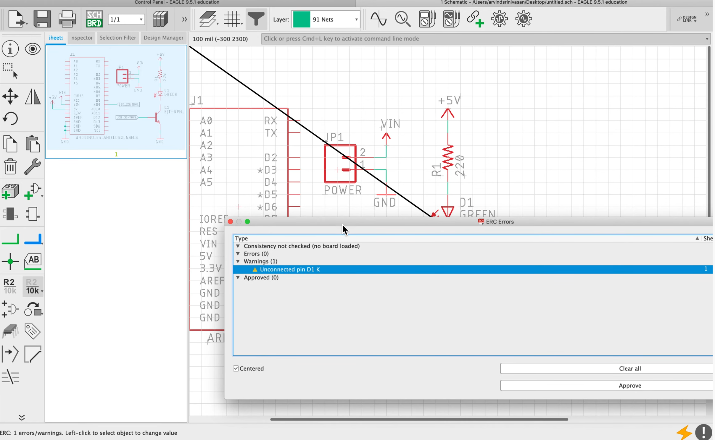
Step 7: Electrical Rules Check (ERC)
Click the dropdown and then
ERC
Or type “erc”
If there are errors or warnings.
Click on the centered box and then click the error or warning to fix it

Slide 41
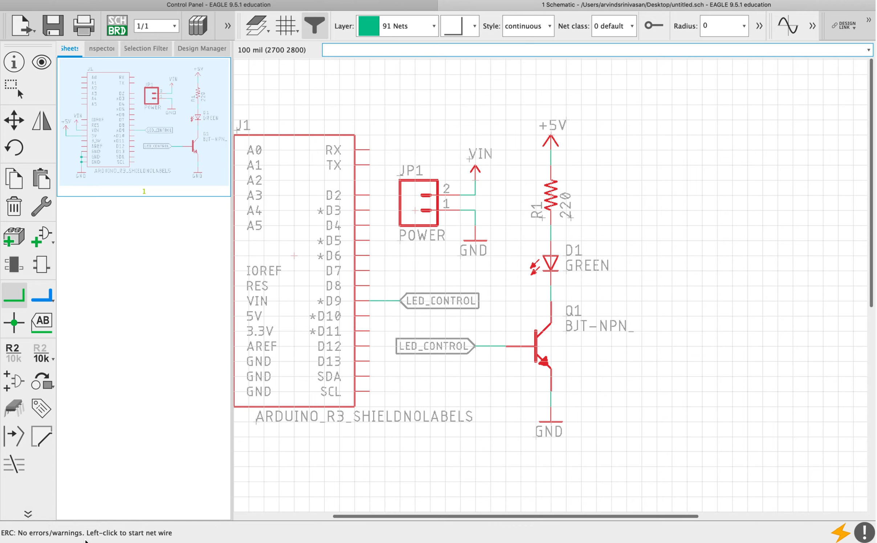
Step 7: Electrical Rules Check (ERC)
If there is no error or warning.
If there’s no warning or error, nothing should pop up and the bottom left corner should be like this

Slide 42
Step 7: Electrical Rules Check (ERC)
ERC is to ensure our schematic is good and all the connections are made
Click on “ERC” on the left bar or type “erc” in the command bar
If there are no warnings or errors, the bottom left corner should say so
If there is a warning or error, an ERC error page will pop up
Check the centered box and then click on the error or warning which will bring you to the site of the error
Fix the issues and rerun ERC again

Slide 43
Lab!
Creating a Schematic in EAGLE
Notes:
Go to GitHub for lab

